Slide 1
Asian Invasion
Toward a Tsunami of APIDA Workshop Presenters

Slide 2
Panelists
Tim Rosenwong
Drew Ishii
Morika Tsujimura
Nayantara Mhatre

Slide 3
History of APIDA Workshops at the People of Color Conference

Slide 4
APIDA People of Color Conference Workshops 2017
Asians Behaving Critically (ABCs): Developing Resources for Asian-American Student Activists
How to be Asian
“Diversity” in the Literary Canon: Asian Representation in the Black/White Paradigm of Race
How Might We Support High School Students of Asian Descent: A Design Thinking Approach
The Thin Veil of Asian Privilege: Perspectives on Asian Identity
Beyond Black and White: Using Multiracial and Asian American Voices to Complicate the Racial Binary
Intersectionality, Immigration, Segregation: Exploring Asian-American and African-American Solidarity

Slide 5
APIDA People of Color Conference Workshops 2016
(In)Visibility of Asian American and Asian Pacific Islander Students in Independent Schools: A Self-Study at San Francisco University High School
Supporting Our Asian American and Pacific Islander Students: Critical Race Theory, Affinity Groups, and More
“A Face Like Mine”: Structurally Including Asian Americans in Racial Justice
Asian Privilege and Its Discontents
Beyond Curry and Cows: Teaching South Asia

Slide 6
Workshops 2015, 2014, 2009, 2008, 2007
2015: Deconstructing Myths: Examining Inclusive Practices for Asian American Students
2014: Asian-American Transracial Adoptees
2009: Myth of the Model Minority: Supporting Pan-Asian Youth in Independent Schools
2008: “Yellow” Privilege: API Identity in the Diversity Dialogue
2007: What’s an Asian Indian to do in This Black and White World?

Slide 7
Workshops 2013, 2012, 2011, 2010

Slide 8
How Do We Increase the Presence of APIDA Workshops at the PoCC?

Slide 9
You!

Slide 10
How Do I Come Up With an Idea?
What questions do you have?
What personal experiences do you think others share with you?
What would help other people?
What is creative, timely, and original?
What areas of Expertise do you possess?
Who do you want to work with?

Slide 11
should I Work with other people?
Yes. Unless you really don’t want to.
Look at a conference proposal as an opportunity to collaborate, to work with new people, to seek answers to questions that challenge you.
Collaboration is a fine way to go, and it doesn't have to look any one type of way. Reach out to people who are doing work you admire or are interested in.

Slide 12
How Do I Find Collaborators?
Be Nice
Ask your friends
Ask your friends to ask their friends
Network at smaller conferences and symposiums (like AsEA)

Slide 13
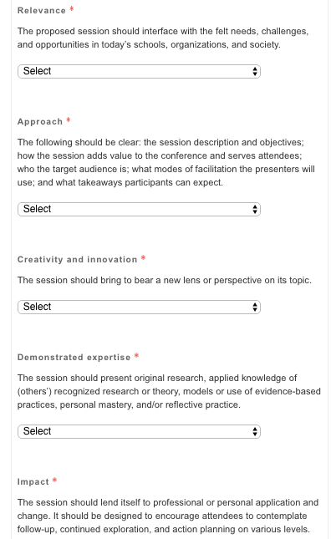
How Do I Write a PoCC Proposal?
Explicitly Answer the Questions!
What is the relevance?
What is your approach?
How is it creative and innovative?
How does it demonstrate expertise?
What will be the impact?

Slide 14
Relevance
The proposed session should interface with the felt needs, challenges, and opportunities in today’s schools, organizations, and society.

Slide 15
Approach
The following should be CLEAR: the session description and objectives; how the session adds value to the conference and serves attendees; who the target audience is; what modes of facilitation the presenters will use; and what takeaways participants can expect.

Slide 16
Creativity and Innovation
The session should bring to bear a new lens or perspective on its topic.

Slide 17
Demonstrated Expertise
The session should present original research, applied knowledge of (others’) recognized research or theory, models or use of evidence-based practices, personal mastery, and/or reflective practice.

Slide 18
Impact
The session should lend itself to professional or personal application and change. It should be designed to encourage attendees to contemplate follow-up, continued exploration, and action planning on various levels.

Slide 19
Do Your Research!
https://pocc.nais.org/Program-Archive

Slide 20
Miscellaneous Advice I: Drew/Saber
Highlighting diversity within “Asian American” and acknowledging the void in Asians voices in the bigger picture of DEI work.
Addressing Model Minority Myth is tired for us in the know, but still lots of people have no idea what it is and believe it.
A good proposal should feel a little scary where you worry about what you might say and how people might react.
Considering turning conference proposal and sessions into written pieces that can be shared digitally. It helps create a record of your ideas and help build a portfolio of writing that helps identify you as a deep thinker.

Slide 21
Miscellaneous Advice II: Drew
Align with the conference strands and go from there. Decide on the title last or use a working title (don’t get hung up on it)
One approach, Use backwards planning. What do you want people to walk away with? Then work backwards
Work from/with bullet points and non-fully realized ideas of lists for a while, then the process will settle on some ideas
Write authoritatively, but not in generalizations that are unfounded

Slide 22
Miscellaneous Advice III: Mo
Don't get discouraged (even if you don't hear back for a long time, even if your proposal is rejected), keep trying
Cast a wide net in terms of the different conferences you are reaching out to. There are local and national conferences, subject-specific conferences, etc., and chances are, you are not overrepresented at any of them.
You can acknowledge imposter syndrome but know that we're all just figuring things out
Be prepared for who might be in the room and make plans to minimize derailment

Slide 23
Miscellaneous Advice IV: Nayantara
As you might with anything, have someone who would not be involved look through your proposal (and your plan for what you do)
Be able to describe the workshop in a short, pithy paragraph that will get the attention of the reader (the committee and eventually attendees) and accurately state the outcomes or experience of the workshop
Potentially "workshop" your workshop at a smaller, local conference or at your own institution

Slide 24
What Are Your workshop Ideas?
Get into small groups
Take about five minutes and share some potential workshop ideas with each other
Reconvene and take advantage of the panelists’ experience and knowledge

Slide 25
What Do I Do Once I’m There?

Slide 26
Questions?

